Slide 1
RISC-V AI Accelerator
By roman revzin

Slide 2
Modules and changes implemented:
Address domain of accelerator increased
from 0x20 - 0x30 to 0x20 – 0x44
Multiplier module
Multiplies two 32 bit registers. Output 32 bit as well.
Adder Module
Summarize two 32 bit registers. Output 32 bit as well.
Mean module
Calculates mean of the given matrix
Zero mean module
Shifts expected value of matrix to zero
Variance module
Calculates variance of the given matrix

Slide 3
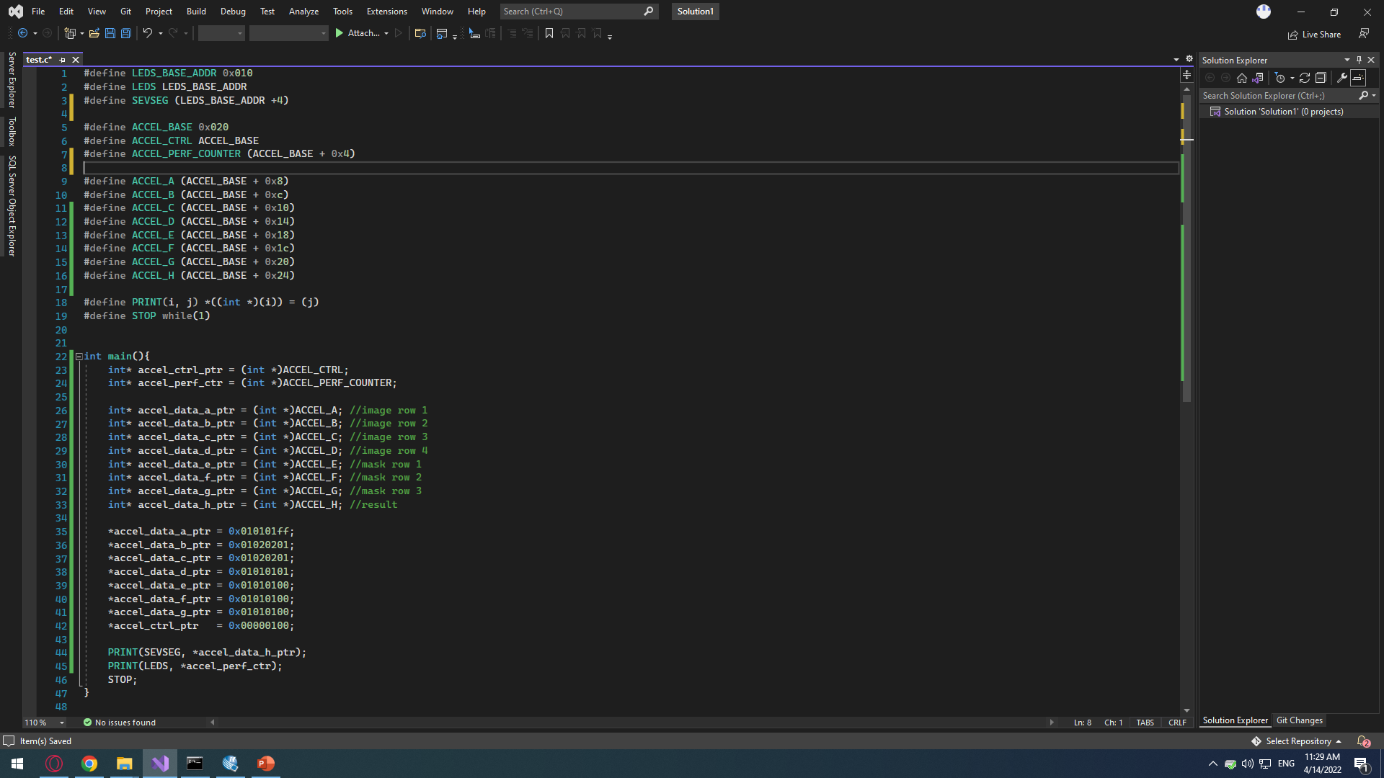
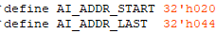
C program
Compiled with gcc 10.1.0:
riscv64-unknown-elf-gcc -Ttext=0 -march=rv32i -mabi=ilp32 test.c -o test & riscv64-unknown-elf-objdump -d test > test.dump & riscv64-unknown-elf-objcopy -O verilog test test.hex --verilog-data-width=4 & .\srec_cat.exe test -binary -o test.mif -mif

Slide 4
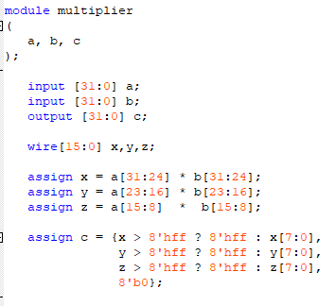
Multiplier
Handles uint8 overflow of output

Slide 5
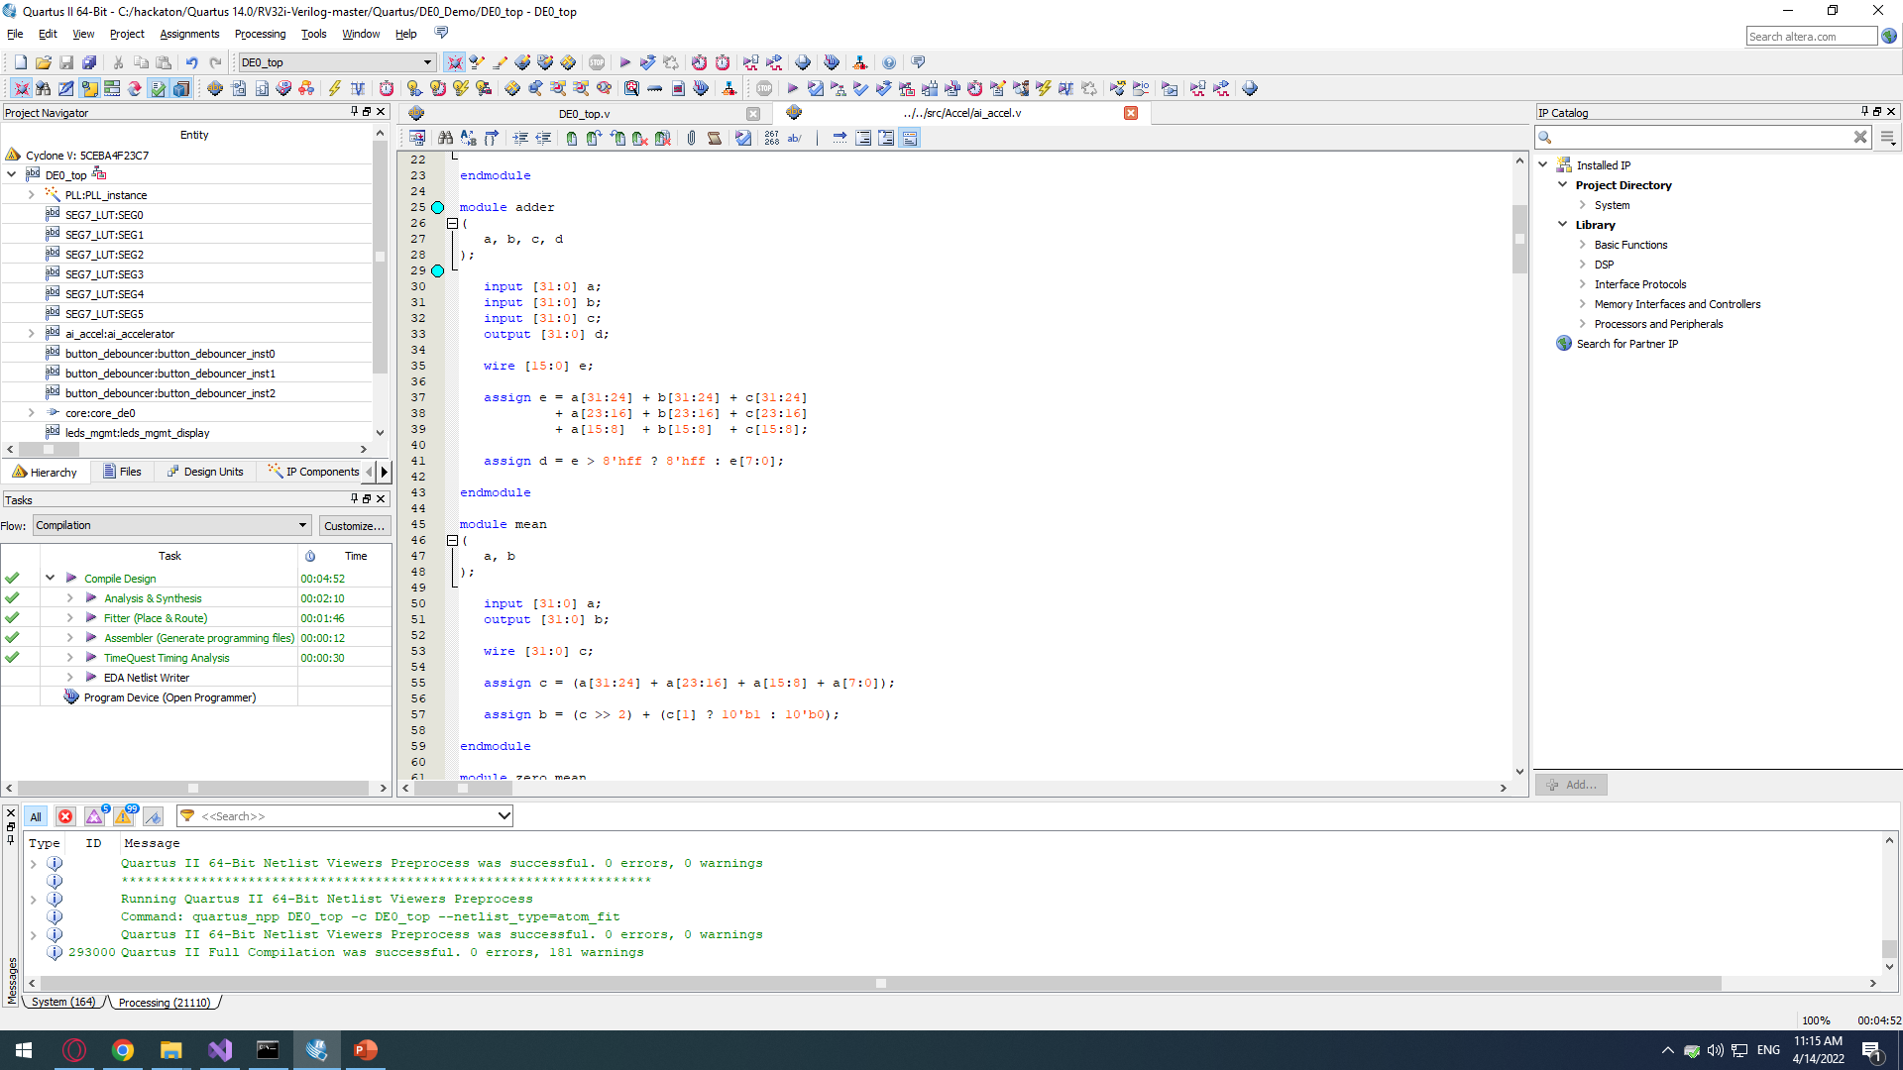
Adder
Handles uint8 overflow of output

Slide 6
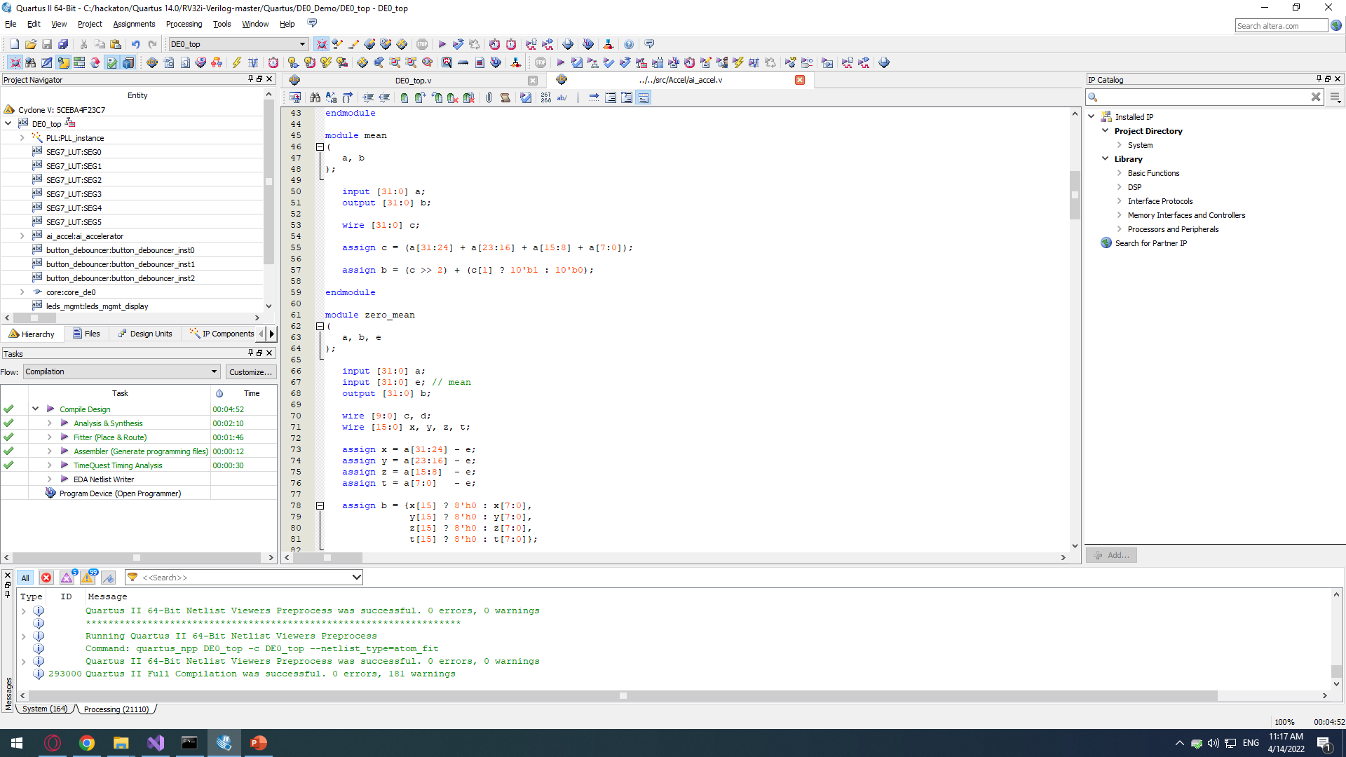
Mean
Handles round up

Slide 7
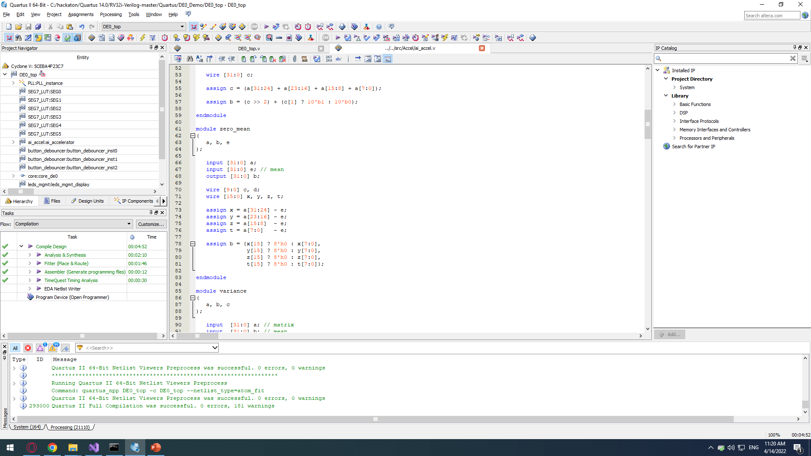
Zero Mean
Handles uint8 casting of negative values

Slide 8
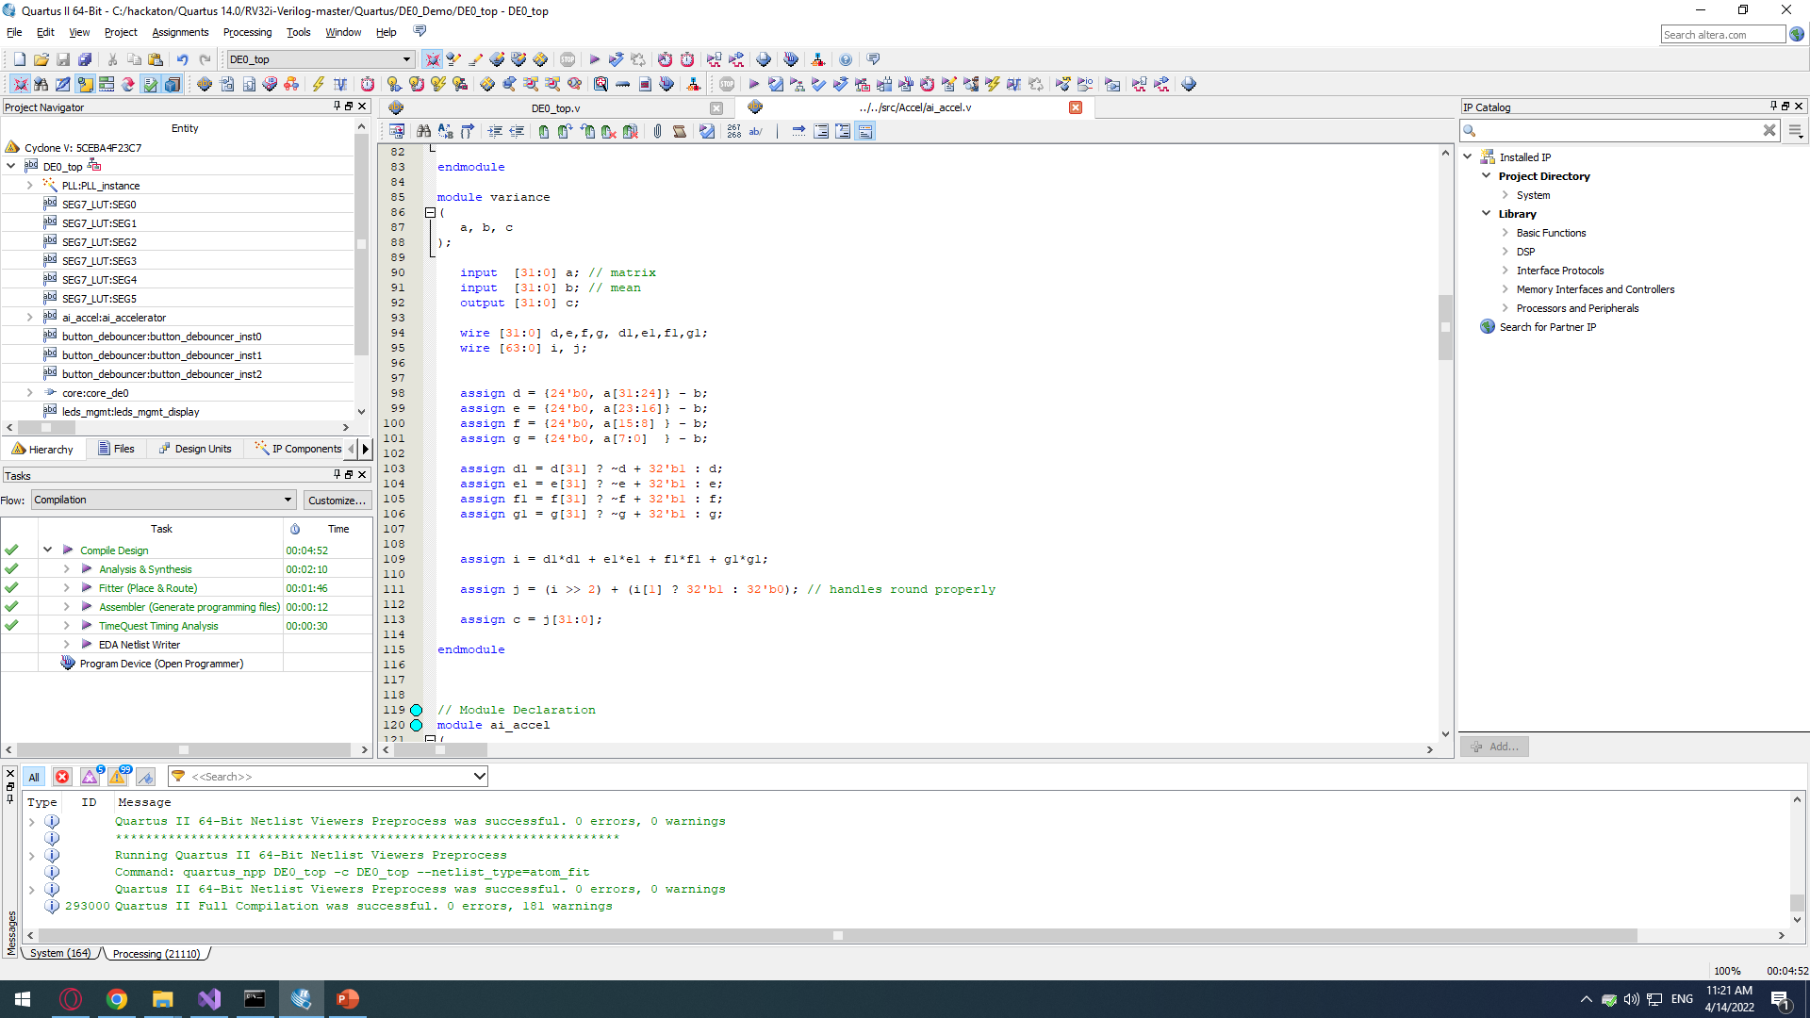
Add a Slide Title - 5
Handles round up. Prevents negative values to be zeroed by uint8 casting.

Slide 9
Performance
All calculations has been performed with combinational circuit, which makes total clock calculation quite complicated.
If we assume propagation delays are negligible compared to the main clock speed, the best performance observed is 6±1 CPU clocks.
Multiple core/thread extension for faster data fetch improve accelerator’s performance significantly.

